Slide 1

Density-Based Smart Traffic Control System Using Canny Edge Detection Algorithm
SOMSAI.D-19BBS0009
VINEESH REDDY.P-19BBS0059
NAGA TEJA – 19BBS0057
Guide: POORNIMA N

Slide 2

Introduction
Traffic congestion is one of the major modern-day crises in every big city in the world. A recent study of the World Bank has shown that average vehicle speed has been reduced from 21 km to 7 km per hour in the last 10 years. Inter-metropolitan area studies suggest that traffic congestion reduces regional competitiveness and redistributes economic activity by slowing growth in county gross output or slowing metropolitan area employment growth. As more and more vehicles are commissioning in an already congested traffic system, there is an urgent need for a whole new traffic control system using advanced technologies to utilize the area's already existing infrastructures to their full extent. Since building new roads, flyovers, elevated expressways, etc. extensive planning, huge capital and lots of time;

Slide 3
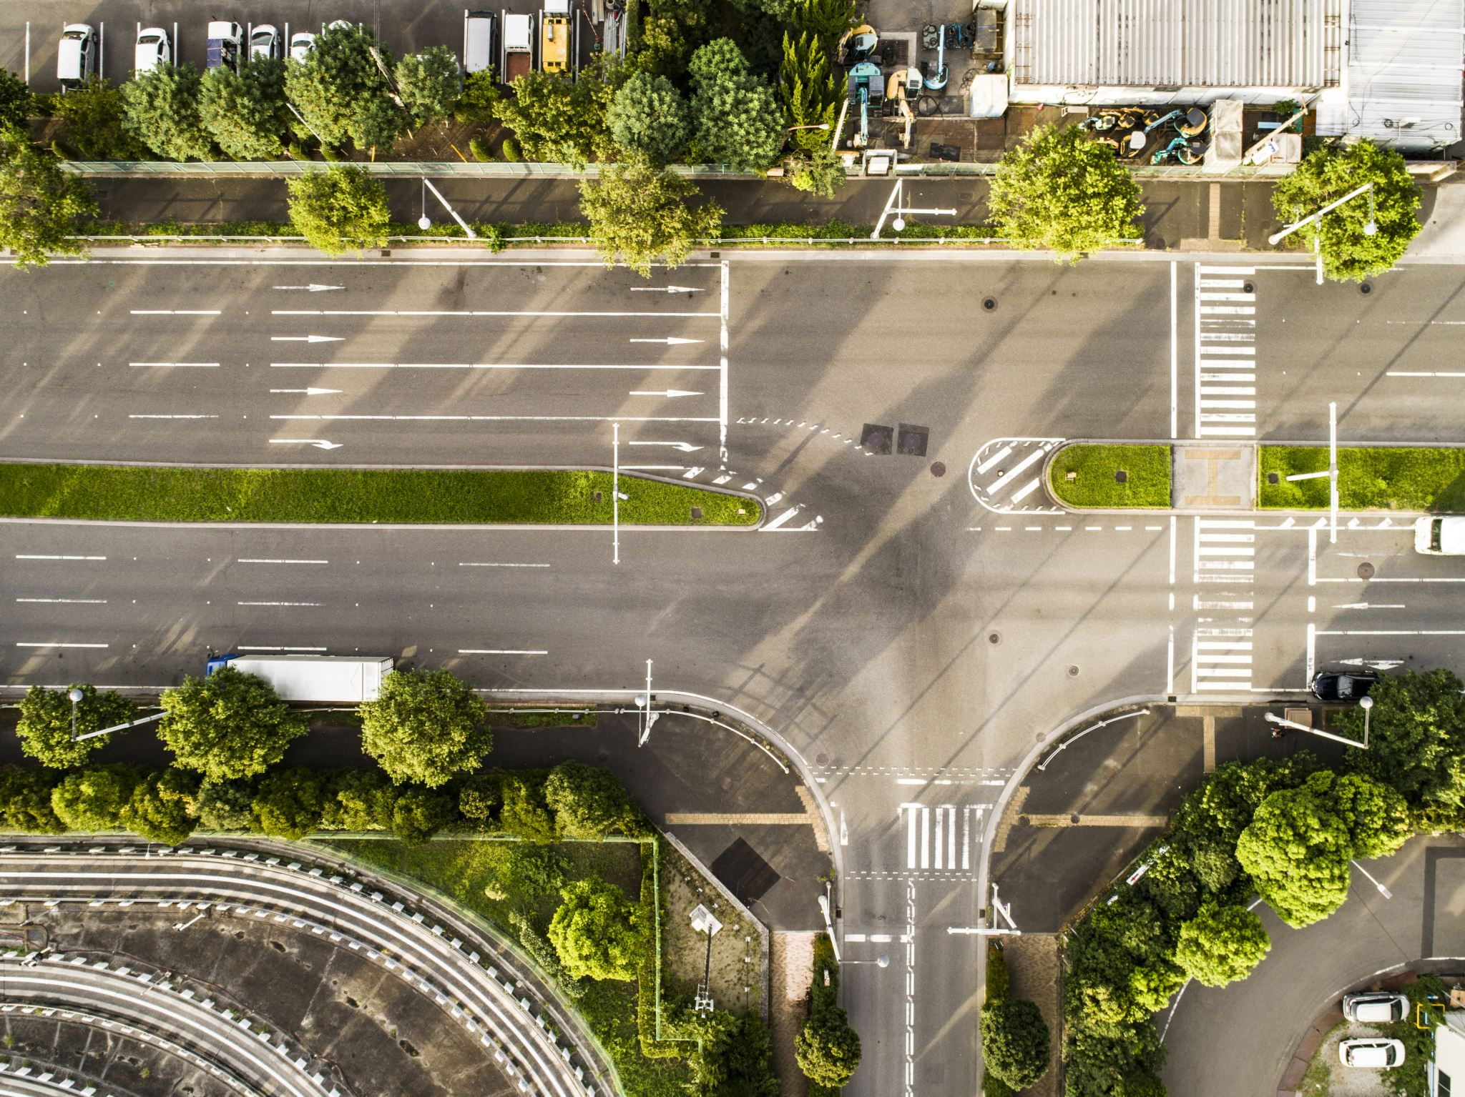
Problem Statement
To propose a smart traffic control system availing image processing as an instrument for measuring the density.
To explain limitations of current near obsolete traffic control system, the advantages of proposed traffic control system.

Slide 4
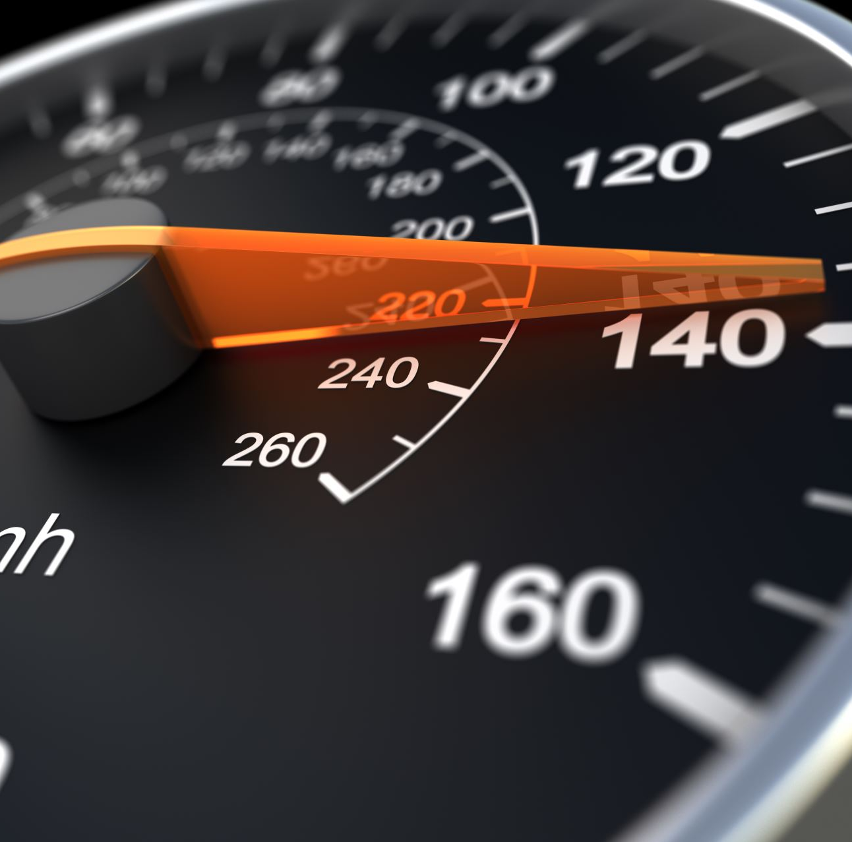
Objectives
A system to control the traffic by measuring the real time vehicle density using canny edge detection with digital image processing is proposed. This imposing traffic control system offers significant improvement in response time, vehicle management, automation, reliability and overall efficiency over the existing systems.

Slide 5
Additional Features
Emergency vehicle priority: The system could give priority to emergency vehicles like ambulances, fire trucks, and police vehicles by automatically changing the traffic signal timings.
The emergency vehicle priority feature in a Density-based Smart Traffic Control System using Canny Edge Detection Technique allows emergency vehicles such as ambulances, fire trucks, and police cars to pass through intersections more quickly and safely. This is done by detecting the presence of an emergency vehicle and adjusting the traffic signal timings to give the emergency vehicle a green light for a longer duration than normal.

Slide 6

The Canny Edge Detection technique is used to detect the presence of vehicles, including emergency vehicles, at an intersection. The traffic density is then calculated based on the number of vehicles detected. The traffic signals are then controlled based on the traffic density, with the priority given to the emergency vehicle if it is detected.
The emergency vehicle priority feature can be implemented by adding a new function, such as the givePriorityToEmergencyVehicles function shown in the code example, which checks if an emergency vehicle is approaching and adjusts the traffic signal timings accordingly. This function can be called in the main loop of the traffic control system, along with the functions to detect vehicles, calculate traffic density, and control the traffic signals.

Slide 7

It is important to note that the emergency vehicle priority feature should be carefully designed and tested to ensure that it works correctly and does not interfere with the normal operation of the traffic control system. Additionally, it may be necessary to integrate the system with other emergency response technologies, such as GPS tracking and communication systems, to ensure that the emergency vehicles are detected accurately and efficiently.

Slide 8
Literature review
M. Sweet, “Traffic Congestion’s Economic Impacts: Evidence from US Metropolitan Regions,” Urban Studies, vol. 51, no. 10, pp. 2088–2110, Oct. 2013
Traffic congestion alleviation has long been a common core transport policy objective, but it remains unclear under which conditions this universal byproduct of urban life also impedes the economy. Using panel data for 88 US metropolitan statistical areas, this study estimates congestion’s drag on employment growth (1993 to 2008) and productivity growth per worker (2001 to 2007). Using instrumental variables, results suggest that congestion slows job growth above thresholds of approximately 4.5 minutes of delay per one-way auto commute and 11,000 average daily traffic (ADT) per lane on average across the regional freeway network.
While higher ADT per freeway lane appears to slow productivity growth, there is no evidence of congestion-induced travel delay impeding productivity growth. Results suggest that the strict policy focus on travel time savings may be misplaced and, instead, better outlooks for managing congestion’s economic drag lie in prioritising the economically most important trips (perhaps through road pricing) or in providing alternative travel capacity to enable access despite congestion.

Slide 9
Vismay Pandit, Jinesh Doshi, Dhruv Mehta, Ashay Mhatre and Abhilash Janardhan, “Smart Traffic Control System Using Image Processing,”International Journal of Emerging Trends & Technology in Computer Science (IJETTCS), Vol. 3, Issue 1, January – February 2014
In this paper they propose a method for determining traffic congestion on roads using image processing techniques and a model for controlling traffic signals based on information received from images of roads taken by video camera. They extracted traffic density which corresponds to total area occupied by vehicles on the road in terms of total amount of pixels in a video frame instead of calculating number of vehicles. They had set two parameters as output, variable traffic cycle and weighted time for each road based on traffic density and control traffic lights in a sequential manner.

Slide 10
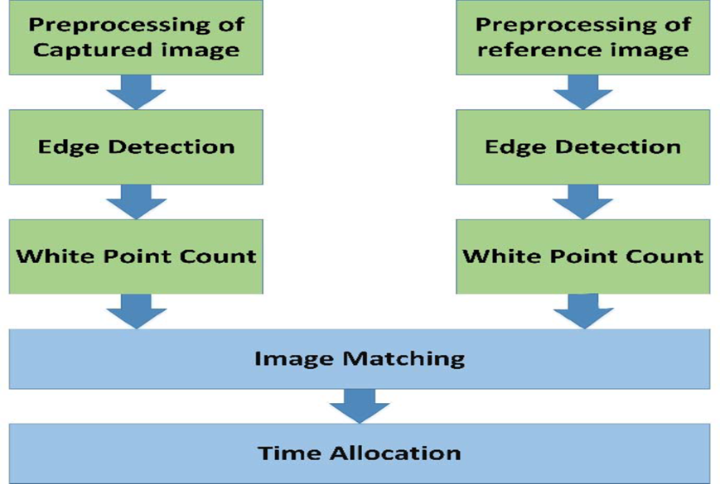
System design
Concept to control or automate green traffic signal allotment time based on congestion available at roadside using Canny Edge Detection Algorithm. To implement this technique we are uploading current traffic image to the application and application will extract edges from images and if there is more traffic then there will be more number of edges with white color and if uploaded image contains less traffic then it will have less number of white color edges. Empty edges will have black color with value 0.
By counting number of non-zeroes white pixels, we will have complete idea of available traffic and based on that we will allocate time to green signal. If less traffic is there, then green signal time will be less otherwise green signal allocation time will be more. To compare current traffic, we will take one reference image with high traffic and comparison will be done between uploaded image white pixels and reference image white pixels. Using below code we will allocate time to green signal.

Slide 11
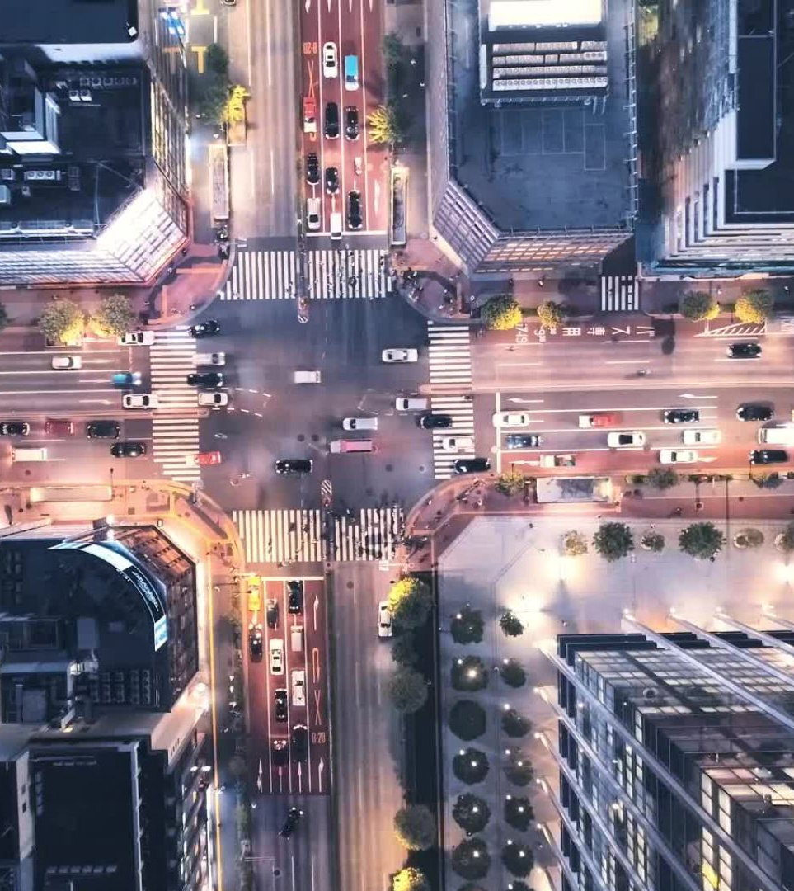
Conclusion
A smart traffic control system availing image processing as an instrument for measuring the density has been proposed. Besides explaining the limitations of current near obsolete traffic control system, the advantages of proposed traffic control system have been demonstrated. For this purpose, four sample images of different traffic scenario have been attained. Upon completion of edge detection, the similarity between sample images with the reference image has been calculated. Using this similarity, time allocation has been carried out for each individual image in accordance with the time allocation algorithm. In addition, similarity in percentage and time allocation has been illustrated for each of the four sample images using Python programming language. Besides presenting the schematics for the proposed smart traffic control system, all the necessary results have been verified by hardware implementation.

